Slide 1
Literature Review
Ma Siyuan June 1~June 8

Slide 2
Paper that I read this week-Efficient Methods and Hardware for Deep Learning
Author-Song Han
101 pages, 6 chapters
I read page 1~40, chapter1, 2 and 3.
Following is the outline of my reading and some notes
at the end are some work that I have done this week

Slide 3
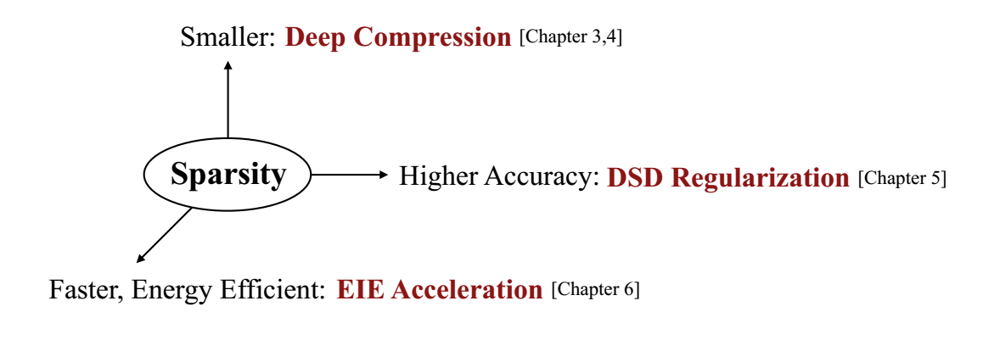
Chap 1-Introduction
Two aspects:
1. Model compression-less exporting overhead, higher inference speed, less energy consumption, less hardware cost
2. Specialized hardware-more efficient data path, more efficient control flow

Slide 4
Chap 2-Background
neuron, layer, connection, weight, training, back-propagation, inference…
Applications of deep learning
Neural network architectures-MLP, CNN, RNN, LSTM, LeNet, AlexNet, VGGNet, GoogleNet…
Datasets-MNIST, Cifar-10, ImageNet, Flickr-8k…
Deep Learning Frameworks-Caffe, Pytorch…

Slide 5
Chap 2-Background
Compressing neural networks: reducing number of parameters, reducing precision and bit width
Regularizing neural networks: weight decay(adding norm), Dropout and Dropconnect, batch normalization, DSD…
Specialized hardware: three waves-dataflow->memory energy->joint hardware/software optimization. Recent trend-sparse neural network accelerators

Slide 6
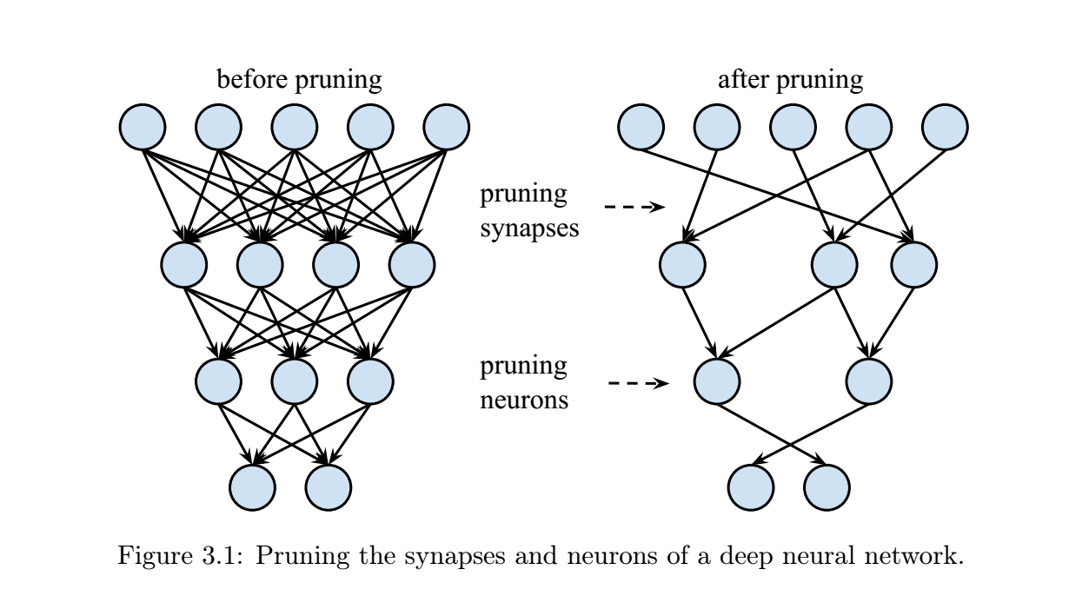
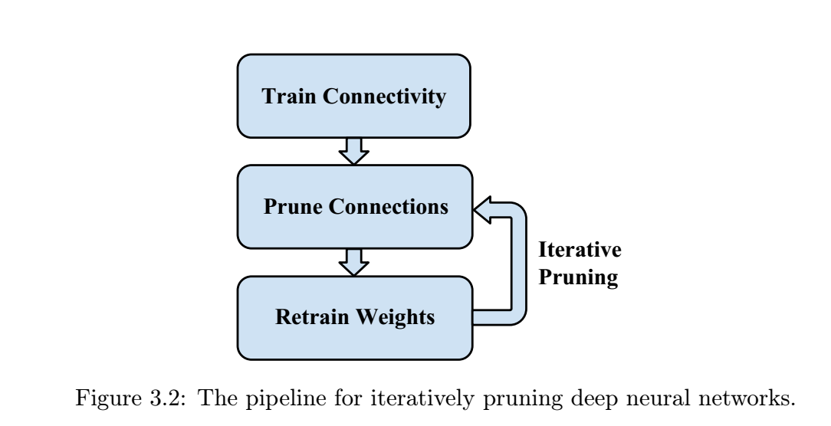
Chap 3-Pruning Deep Neural Networks
Concept: removes redundant connections and learns only important connections
Initial training phase, pruning, retrain
Direct pruning and iterative pruning

Slide 7
Chap 3-Pruning Deep Neural Networks
Hardware efficiency considerations: Pruning reduces the regularity of the remaining hardware. More difficult to parallelize in hardware.
Load-Balance-Aware Pruning: PEs, workload imbalance, adopting constraints to pruning
Pruning with Structure: pruning at different granularities-vector, kernel, filter, more non-zero parameters but less index for coarse-grained sparsity

Slide 8
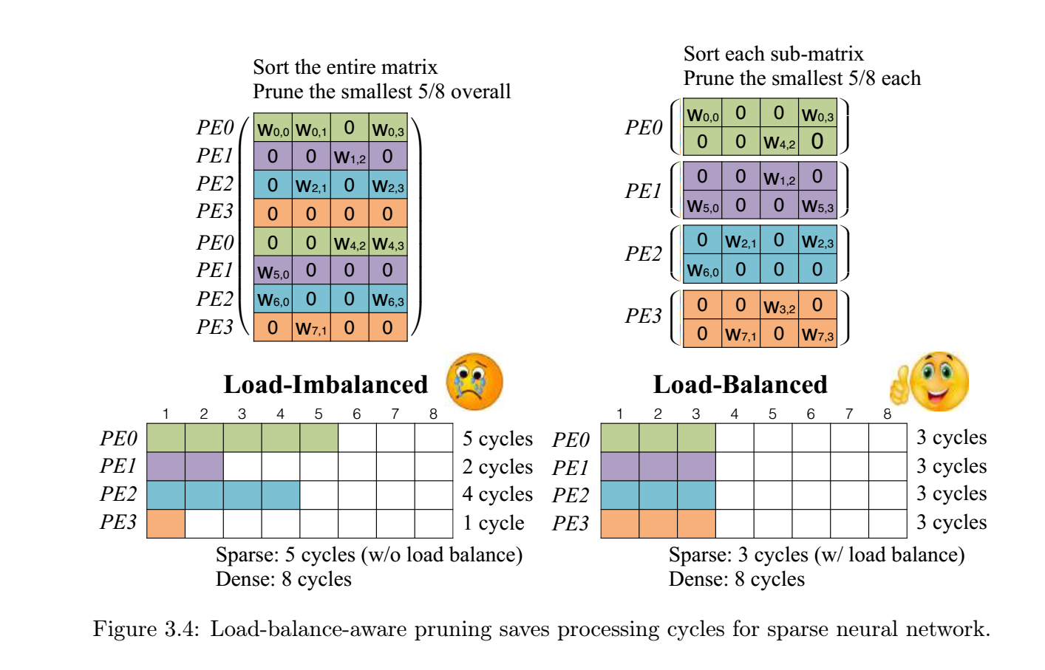
Chap 3-Pruning Deep Neural Networks

Slide 9
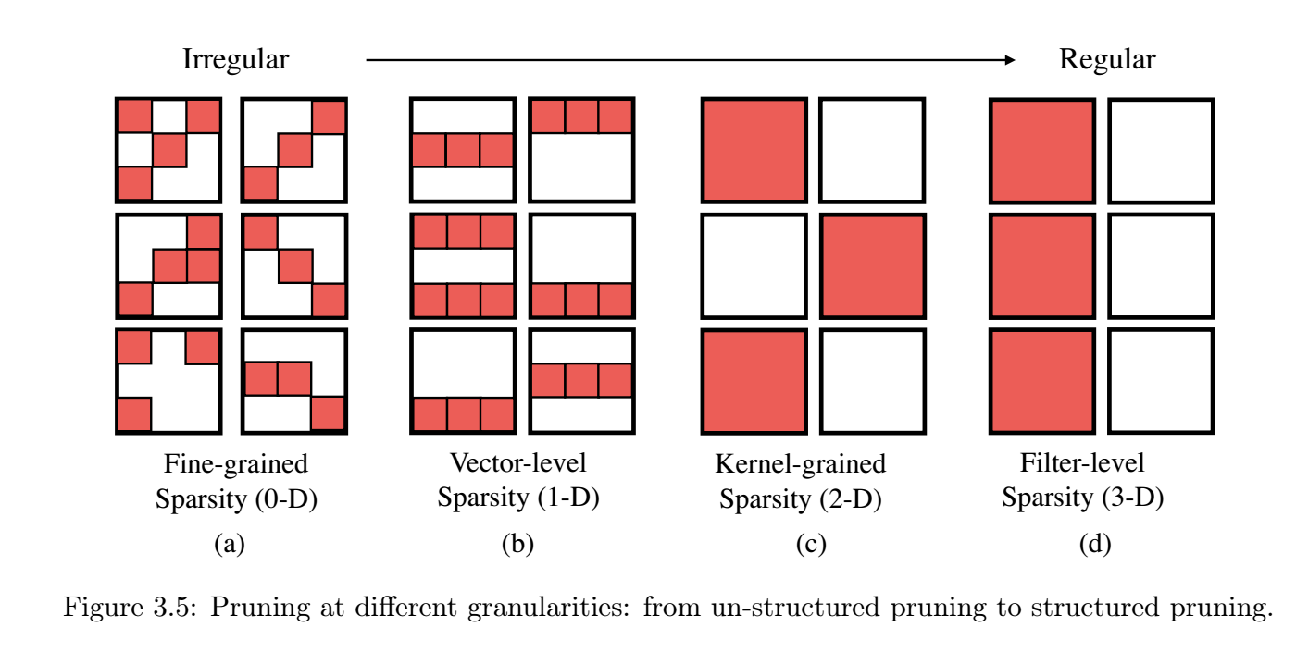
Chap 3-Pruning Deep Neural Networks

Slide 10
Chap 3-Pruning Deep Neural Networks
Experiments of pruning on several neural network architectures
Speedup and Energy efficiency brought by pruning

Slide 11
My work this week
Project: An FPGA-oriented tool for building efficient neural networks
My progress: Completed several CPU operations-maxreduce, argmin, argmax

